Slide 1
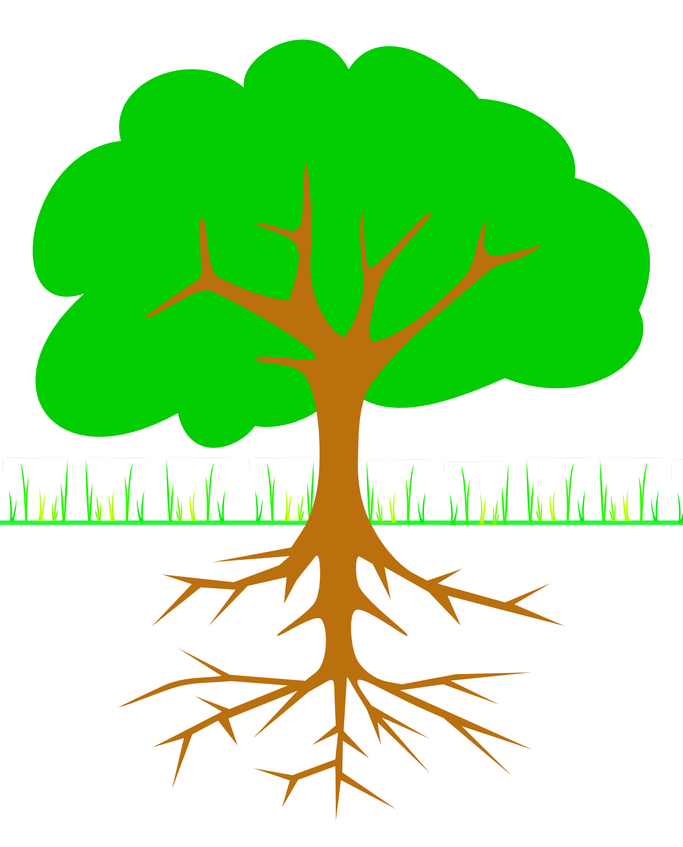
Problem Tree Analysis Exploring causes and effects
Side Effect
Secondary Effect
Side Effect
Primary Effect
Primary Effect
Problem
Cause
Cause
Root Cause
Root Cause
Root Cause

Slide 2

Problem Tree Analysis Exploring causes and effects
Side Effect
Secondary Effect
Side Effect
Primary Effect
Primary Effect
Problem
Cause
Cause
Root Cause
Root Cause
Root Cause

